Slide 1
NeuroSync
Bridging the Gap in Neural Communication
Presented By: Kavibharathi

Slide 2
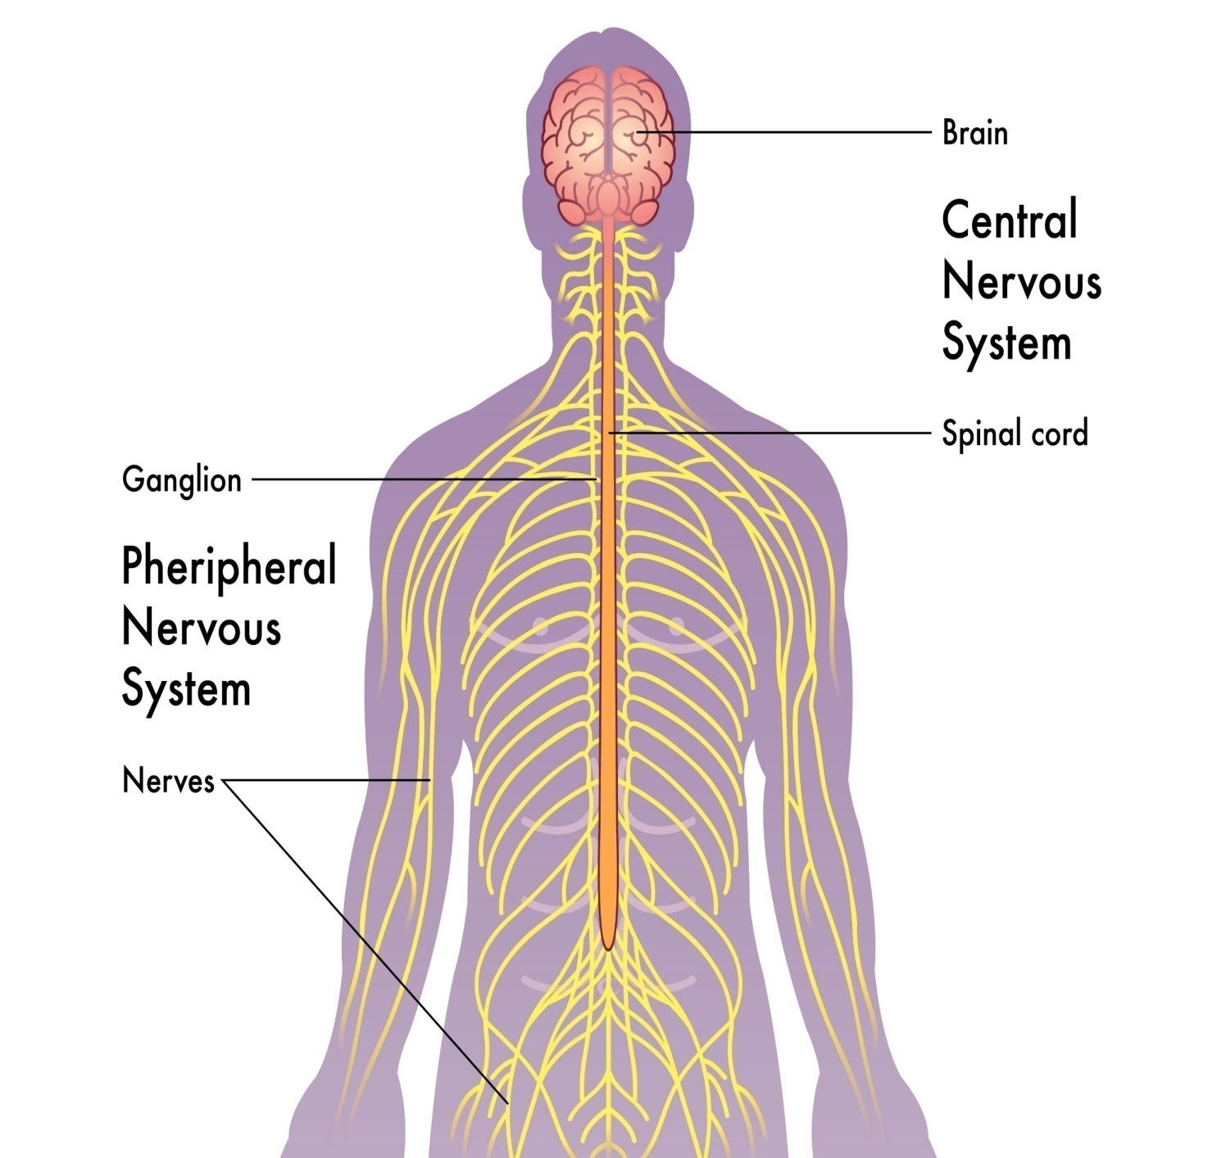
The Control Center- The Nervous System
The Concept: The Nervous System is the master controller of the body. It dictates how we think, feel, and move.
Two Major Divisions:
Central Nervous System (CNS): The Brain & Spinal Cord.
Peripheral Nervous System (PNS): The network of nerves connecting the brain to the limbs.
The Goal: Our project focuses on restoring the broken connection between these two systems.

Slide 3
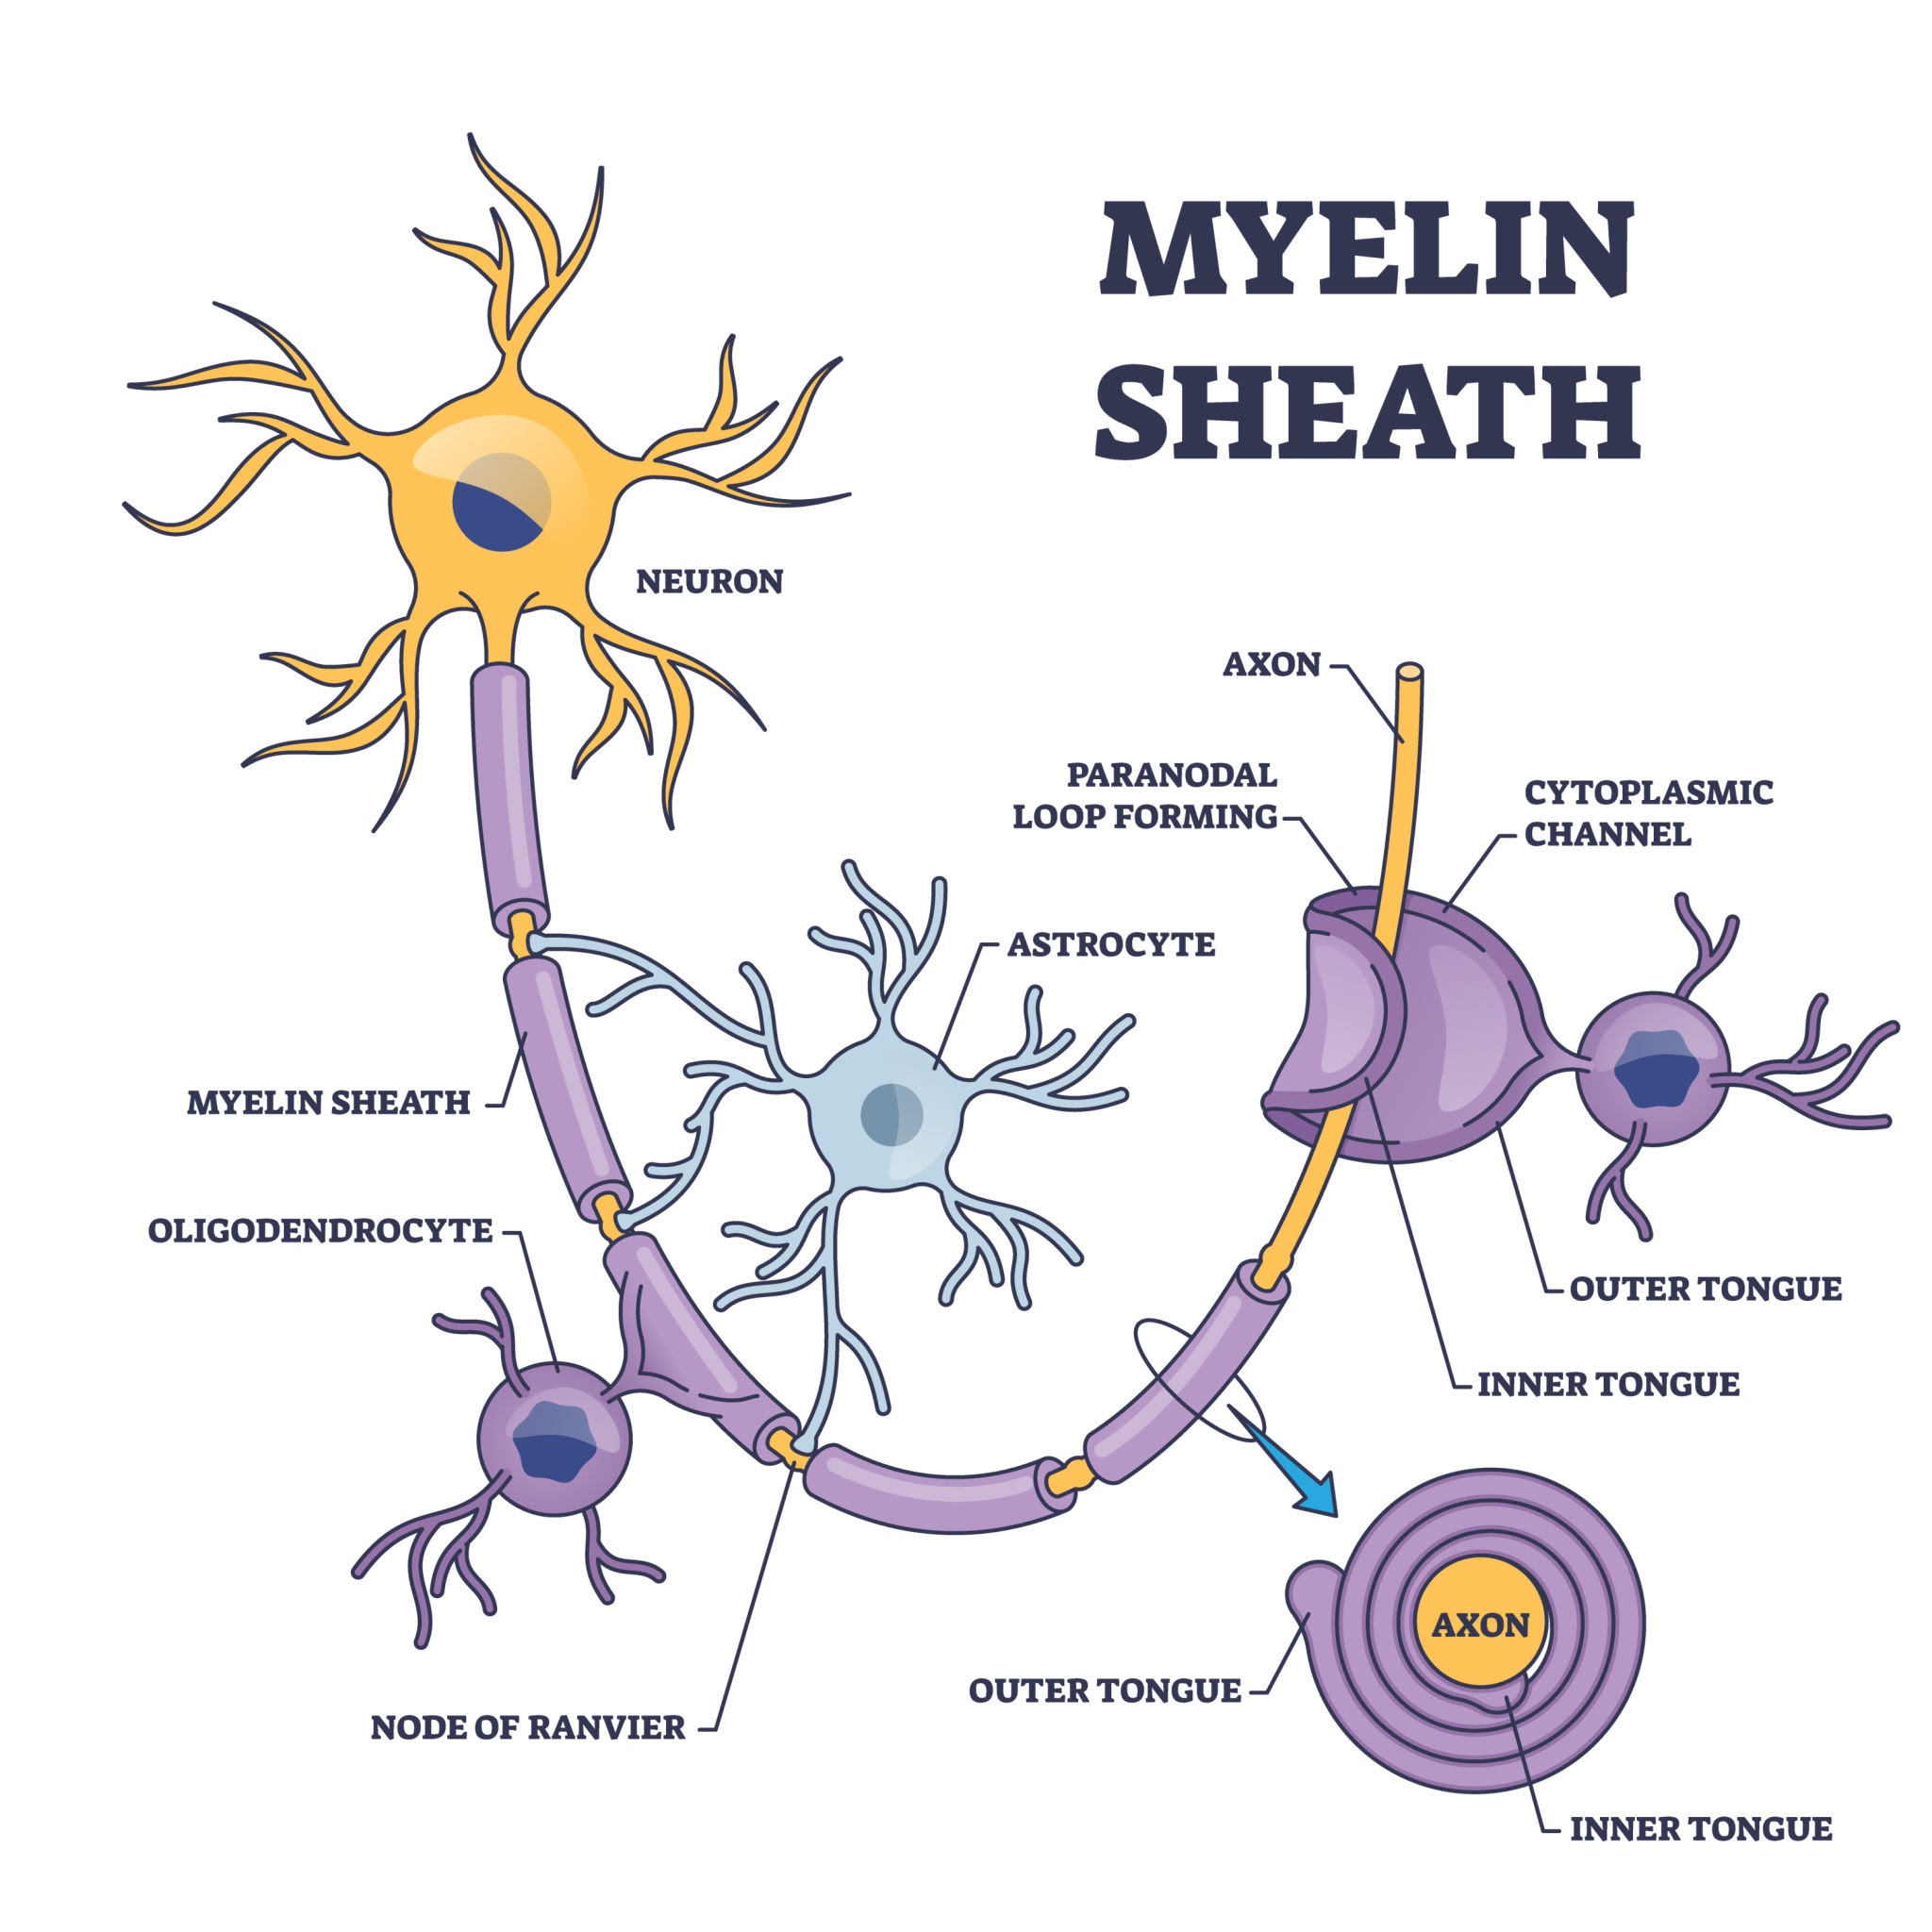
The Fundamental Unit: The Neuron
Definition: Neurons are electrically excitable cells that transmit signals.
Key Parts:
Soma (Cell Body): The life center.
Dendrites: The Receivers. They collect signals from other cells.
Axon: The Transmitter. A long cable that sends signals out.
Relevance: In stroke patients, this transmission path is damaged. NeuroSync acts as an artificial external bridge.

Slide 4
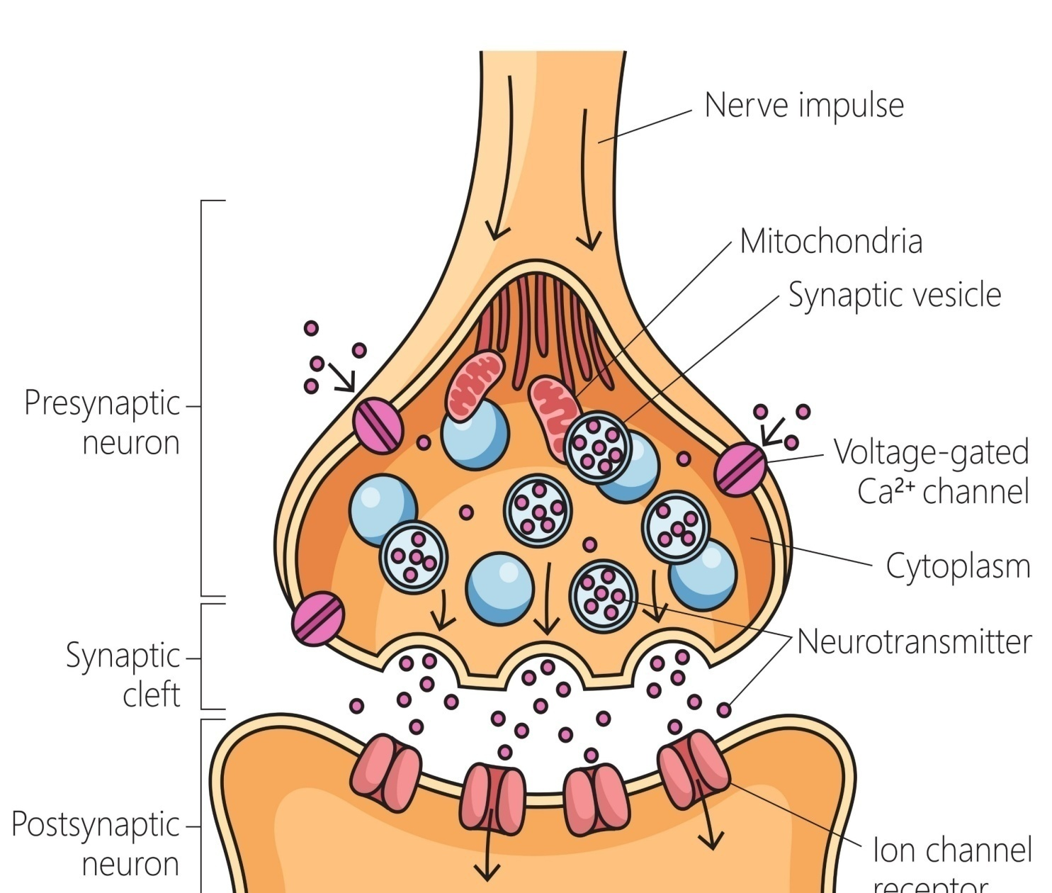
Synapse & Action Potential
Action Potential: The rapid electrical signal that travels down the Axon.
The Synapse: The gap between two neurons where the signal changes from Electrical Chemical Electrical.
Why this matters:
Excitation: Making a muscle move.
Inhibition: Stopping unwanted movement (tremors).
Insight: our project Servo Motors = muscles, and ESP32 =Synapse.

Slide 5
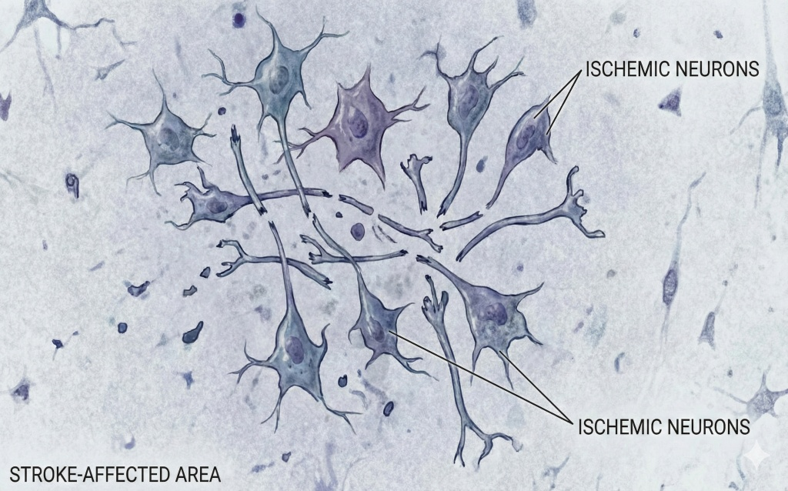
Clinical Neurology - When the System Fails: Stroke & Paralysis
Neurology: The medical science of diagnosing nervous system disorders.
The Issue: Conditions like Stroke or Spinal Cord Injury disrupt the "Efferent" (outgoing) signals from the CNS to the PNS.
The Result: The brain says "Move," but the hand doesn't listen.
Diagnostics: Doctors use MRI, CT Scans, and EMG (Electromyogram) to locate the damage.

Slide 6
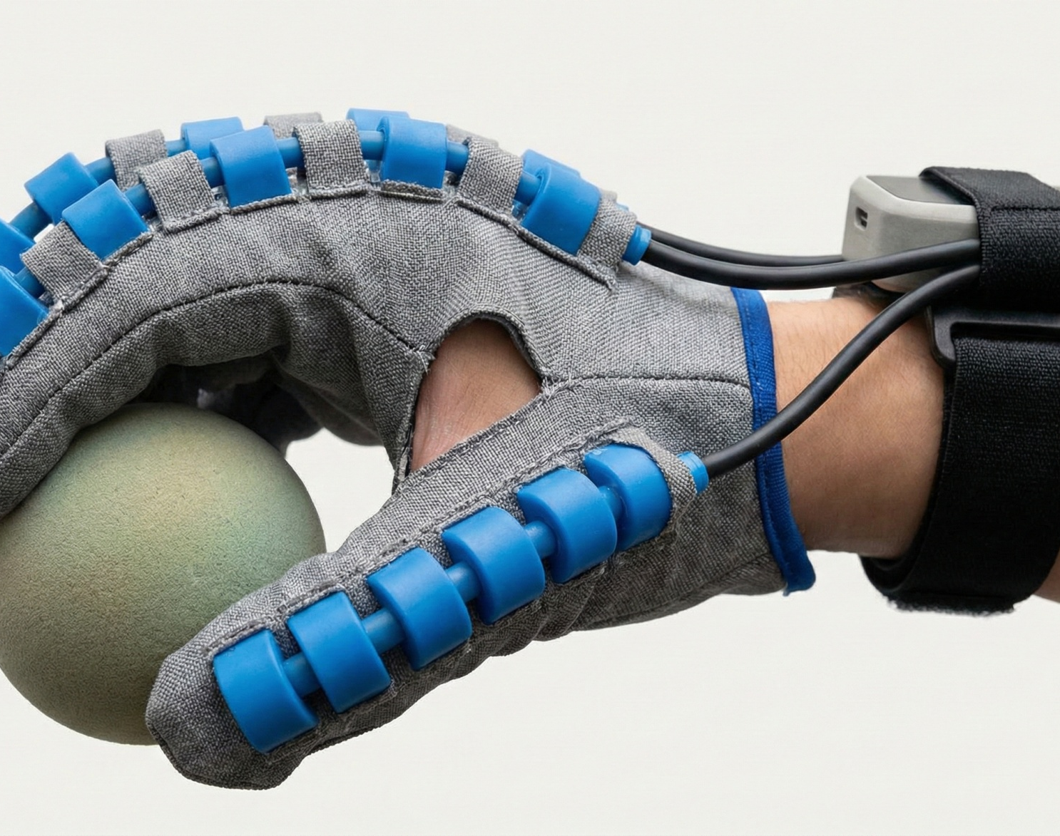
NeuroSync: The Robotic Physiotherapist
The Innovation: A Soft-Robotic Exoskeleton that assists hand movement.
How it mimics Biology:
Sensors (Flex/EMG): Act as the Dendrites (Receiving intent).
ESP32 Controller: Acts as the Soma/CNS (Processing logic).
Servo Motors: Act as the Muscles/Effectors (Executing movement).
Neuroplasticity: By repeatedly moving the hand, we use "Hebbian Learning" (Neurons that fire together, wire together) to retrain the brain.

Slide 7
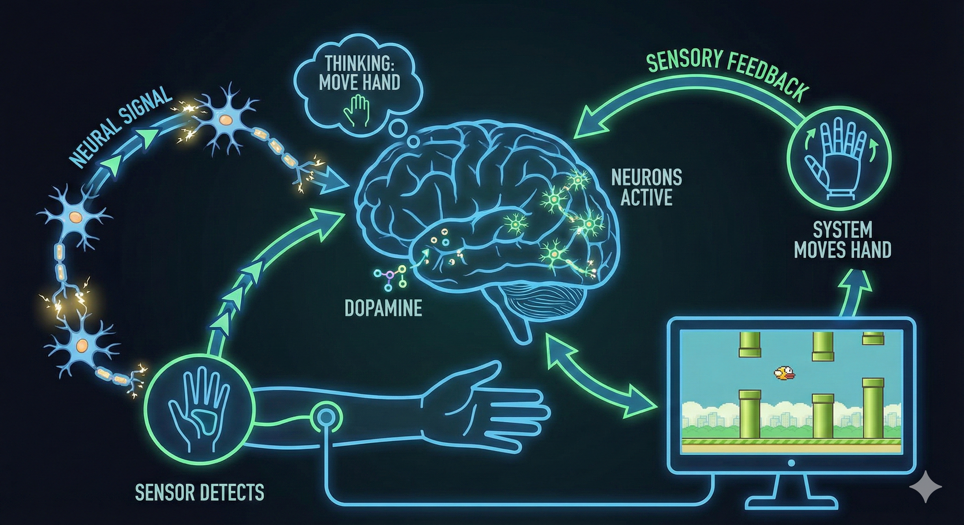
The neurosync cycle
The brain think the hand move ,the signal trainsfer among the neurons .
This signal is detected using the sensor (EMG or(FLUX sensor –this is low cost) it sends the signal to microcontroler
ESP32 Dev Module (30 Pin, Wi-Fi/BT) it will move servomotor then the signal transfer to system the floppy bird game move.
Then return the signal to brain (the hand is moved)it will increase the dobomine it will help to rescue the patient from the strock

Slide 8
The neurosync
Component Specification
Microcontroller ESP32Module (30 Pin, Wi-Fi/BT)
Servo Motors MG996R
Servo Driver PCA9685
Flex Sensors 2.2 inch Bend Sensor

Slide 9
The solution
cycle
This is the most important medical point for your presentation:
Patient Thinks: "I want to move." (Brain fires neurons).
Robot Senses: "I hear the neurons!" (via EMG).
Robot Moves: The glove pulls the finger.
Brain Sees: "Wow! I thought about moving, and my hand moved!"
This loop rewires the brain. This is called Hebbian Learning ("Neurons that fire together, wire together").

Slide 10
The "Secure" Architecture
The Challenge: Medical devices (IoMT) are vulnerable to hacking.
Our Solution:
AES-256 Encryption: Protecting patient neural data.
AI Fatigue Detection: Prevents over-exertion during therapy.
The Source (Patient Side):
Data: The "Flex Sensor" values (e.g., Flex: 80%) are generated by the Glove.
The Lock: Before this data leaves the ESP32 chip, your code wraps it using the AES-256 Key.
Result: The data changes from readable text ({"flex":80}) into garbage text (U2FsdGVkX1+...).
The Tunnel (Transmission):
This encrypted "garbage" travels over the air (Wi-Fi).
The Security: If a hacker "sniffs" the Wi-Fi packets here, they see nothing but random characters. They cannot change the medical data because they don't have the key.
The Destination (Doctor/Game Side):
The Unity Application receives the "garbage."
The Key: Unity has the matching AES-256 Key.
The Unlock: It decrypts the message back into Flex: 80% and moves the game character.

Slide 11

The Future of Rehabilitation
Summary: The nervous system is complex, but technology allows us to bridge the gaps caused by injury.
Vision: From a "Scientific Concept" to a "Life-Changing Device."
"We don't just fix hands; we restore the connection to life."

Slide 12
Thank you
This is Kavibharathi
From TamilNadu
AAA college of engineering and tech
Sivakasi ,Tamilnadu

